Slide 1
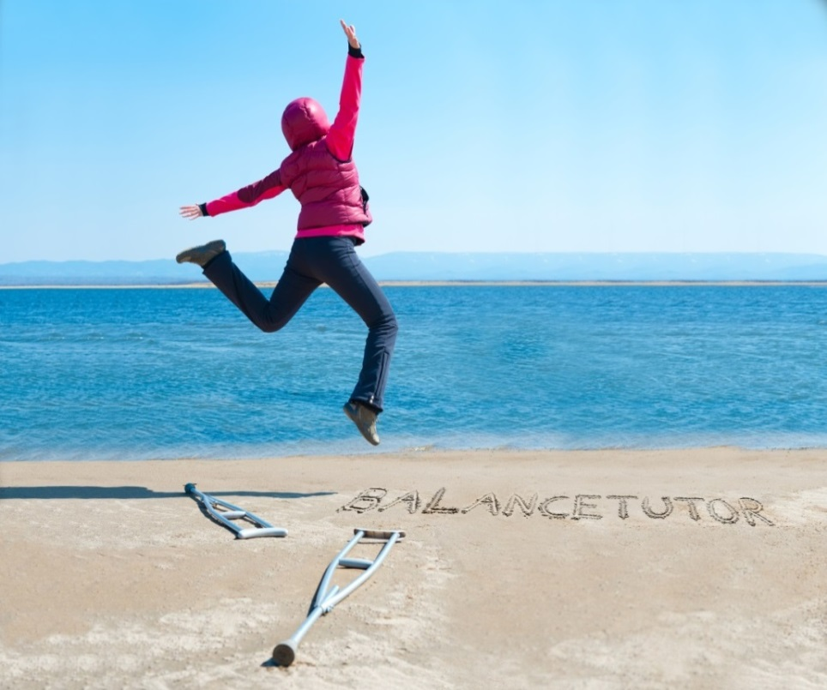
XXVI International Conference on Sports rehabilitation and Traumatology

Slide 2
CONTENTS
1
SCIENTIFIC BACKGROUND
2
BALANCETUTOR SYSTEM
3
CLINICAL APPLICATIONS
XXVI International Conference on Sports rehabilitation and Traumatology
Notes:
in this meeting, we talk about 3 main items. the first one is scientific aspect behind postural control and balance ability in regards to concept as well as rehabilitation point of view. in the second section we will talk about Balance Tutor as a system. how it works and what ability the system has. and in the last section we will talk about clinical application using the system. in other words how we can apply relevant understanding from scientific studies into the clinical rehabilitation by using the system.

Slide 3
Scientific Background
XXVI International Conference on Sports rehabilitation and Traumatology

Slide 4
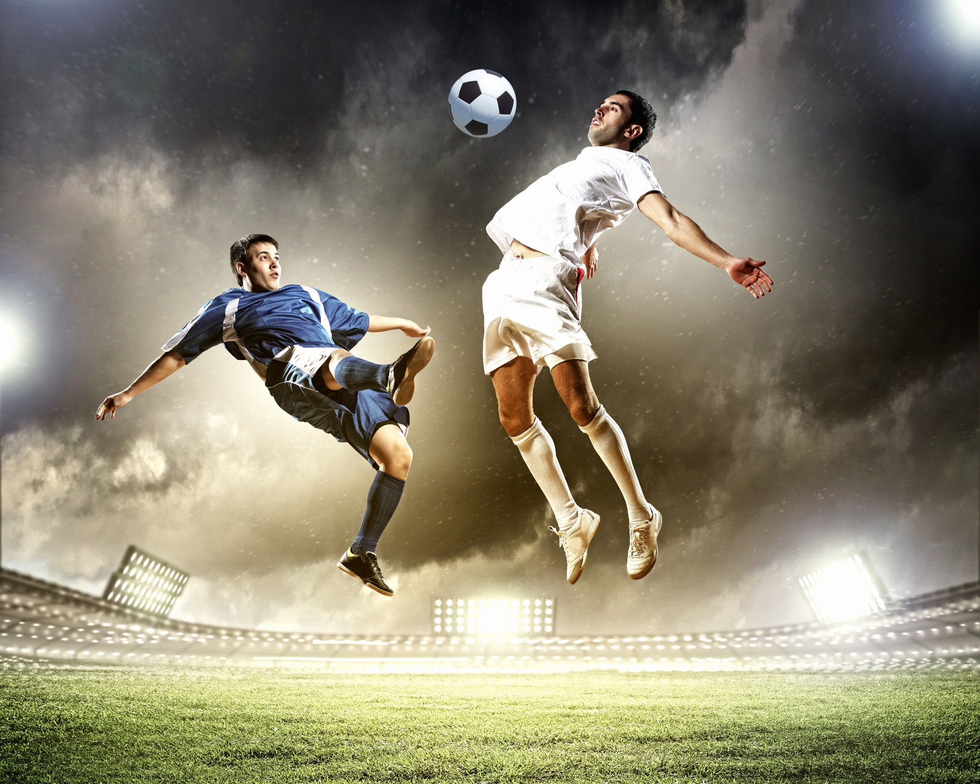
Postural control & Balance
Getting Back To The Best Ability
XXVI International Conference on Sports rehabilitation and Traumatology
Notes:
4
Optimizing the neuromuscular system function for best performance/ ability.

Slide 5
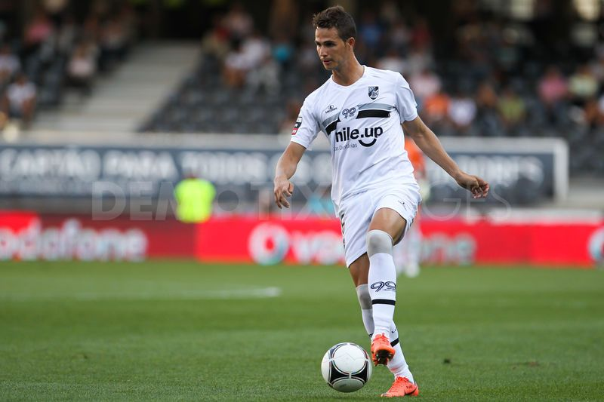
Proactive - planned response
XXVI International Conference on Sports rehabilitation and Traumatology
Notes:
There are two main types of balance responses:
Proactive responses - postural control responses that the body uses them when it is aware of coming balance disturbances ( expected perturbation) in advance. For example just walking on street without any surprising obstacles during the walking. In this case the body “sees” and feels the sidewalk and plans its movement according to the sidewalk situation in advance. For instance, if the sidewalk is gliding (oil or snow on it), the body decrease it’s movement and stabilizes itself before walking on that and will be more careful while walking on it. These kind of responses are responsible for maintaing the line of gravity over the base of support continuously during the task performance.
Reactive responses - like reflex responses that the body uses them when the body is surprised by external obstacles that it was not aware of them in advance like slipping or tripping during the walking.
The body’s aim is to try and keep the Line of the gravity over current base of support by returning the center of mass to its initial location after perturbation occurrence. This strategy is called Automatic Postural Adjustment (APT)
If the first strategy ( APT) is unable to keep the Line of the gravity over current base of support, the second strategy is called a compensatory step- will be executed. In this case the body will try to create a new location of Center of mass that will be safe. The body creates this location by performing a compensatory step to the opposite side of the perturbation to enlarge the base of support.

Slide 6
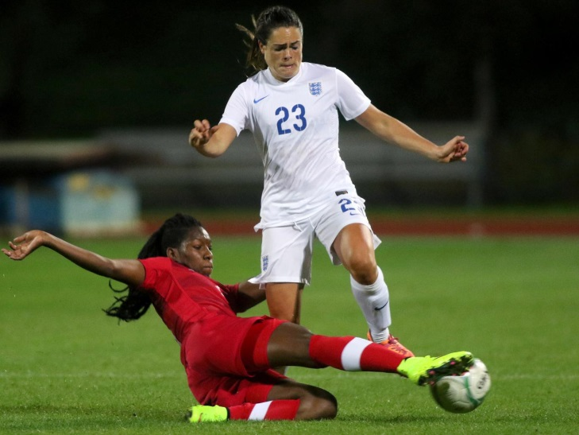
Reactive - like reflex response
XXVI International Conference on Sports rehabilitation and Traumatology
Notes:
There are two main types of balance responses:
Proactive responses - postural control responses that the body uses them when it is aware of coming balance disturbances ( expected perturbation) in advance. For example just walking on street without any surprising obstacles during the walking. In this case the body “sees” and feels the sidewalk and plans its movement according to the sidewalk situation in advance. For instance, if the sidewalk is gliding (oil or snow on it), the body decrease it’s movement and stabilizes itself before walking on that and will be more careful while walking on it. These kind of responses are responsible for maintaing the line of gravity over the base of support continuously during the task performance.
Reactive responses - like reflex responses that the body uses them when the body is surprised by external obstacles that it was not aware of them in advance like slipping or tripping during the walking.
The body’s aim is to try and keep the Line of the gravity over current base of support by returning the center of mass to its initial location after perturbation occurrence. This strategy is called Automatic Postural Adjustment (APT)
If the first strategy ( APT) is unable to keep the Line of the gravity over current base of support, the second strategy is called a compensatory step- will be executed. In this case the body will try to create a new location of Center of mass that will be safe. The body creates this location by performing a compensatory step to the opposite side of the perturbation to enlarge the base of support.

Slide 7
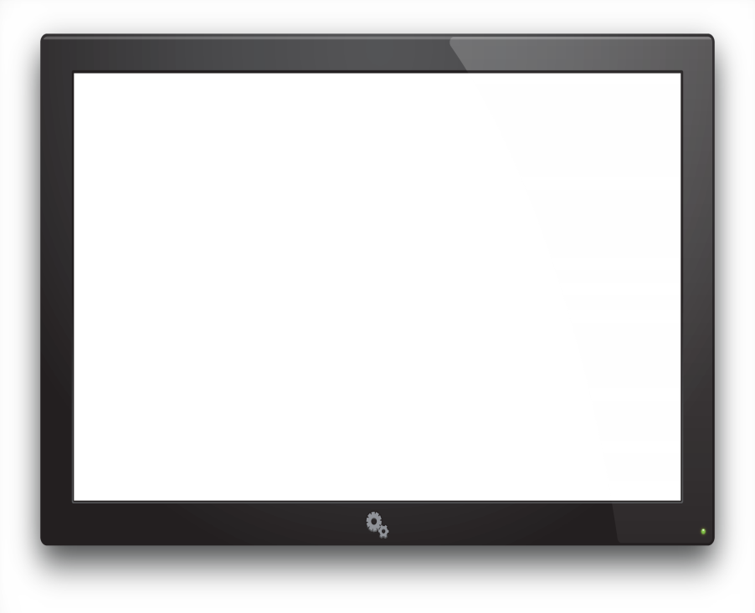
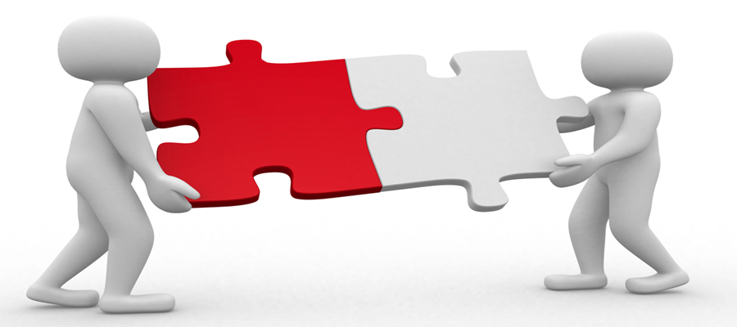
Spatial Temporal Synergy
Reactive - like reflex response
Proactive - planned response
XXVI International Conference on Sports rehabilitation and Traumatology
Notes:
There are two main types of balance responses:
Proactive responses - postural control responses that the body uses them when it is aware of coming balance disturbances ( expected perturbation) in advance. For example just walking on street without any surprising obstacles during the walking. In this case the body “sees” and feels the sidewalk and plans its movement according to the sidewalk situation in advance. For instance, if the sidewalk is gliding (oil or snow on it), the body decrease it’s movement and stabilizes itself before walking on that and will be more careful while walking on it. These kind of responses are responsible for maintaing the line of gravity over the base of support continuously during the task performance.
Reactive responses - like reflex responses that the body uses them when the body is surprised by external obstacles that it was not aware of them in advance like slipping or tripping during the walking.
The body’s aim is to try and keep the Line of the gravity over current base of support by returning the center of mass to its initial location after perturbation occurrence. This strategy is called Automatic Postural Adjustment (APT)
If the first strategy ( APT) is unable to keep the Line of the gravity over current base of support, the second strategy is called a compensatory step- will be executed. In this case the body will try to create a new location of Center of mass that will be safe. The body creates this location by performing a compensatory step to the opposite side of the perturbation to enlarge the base of support.

Slide 8
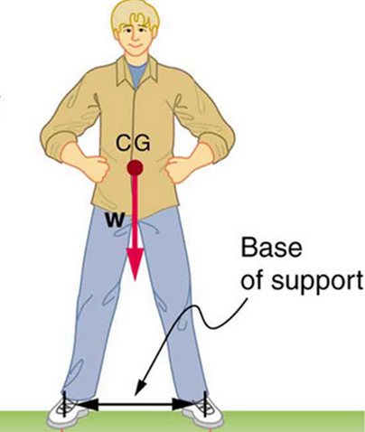
Balance
Balance is the ability to maintain the line of Gravity (W) within the base of support with minimal postural sway.
Balance is produced by Neuromuscular, Musculoskeletal, Vestibular and sensation system.
Jonas, 2005
XXVI International Conference on Sports rehabilitation and Traumatology

Slide 9
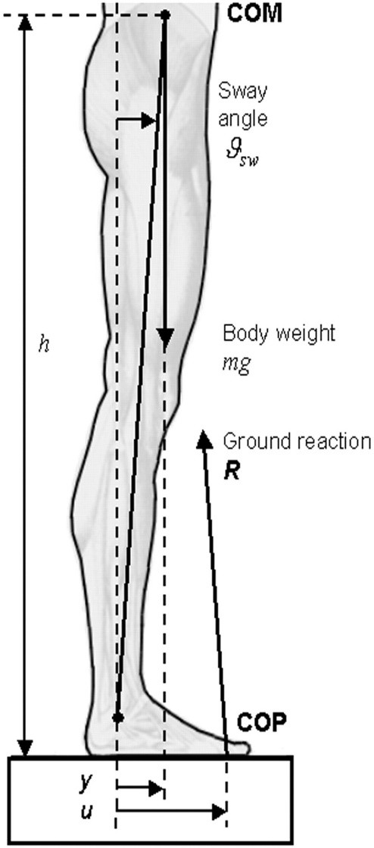
Biomechanics
COM is the mean location of a distribution of mass in space.
Chaffin 1992
LOG is the vertical projection of the center of mass to the ground.
Hall 2003
COP is the point where the resultant of all ground reaction forces act.
Hall 2003
XXVI International Conference on Sports rehabilitation and Traumatology

Slide 10
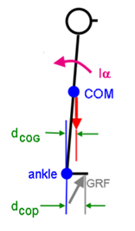
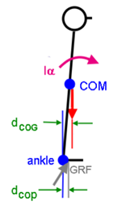
Biomechanics
Balance
Compensatory Step
XXVI International Conference on Sports rehabilitation and Traumatology
Notes:
Movement - COM – Shifting Change in COG mechanoreceptors in sensory and Deep sensation soft tissue muscle spindle and golgi in tendons and vestibular and sensational result

Slide 11
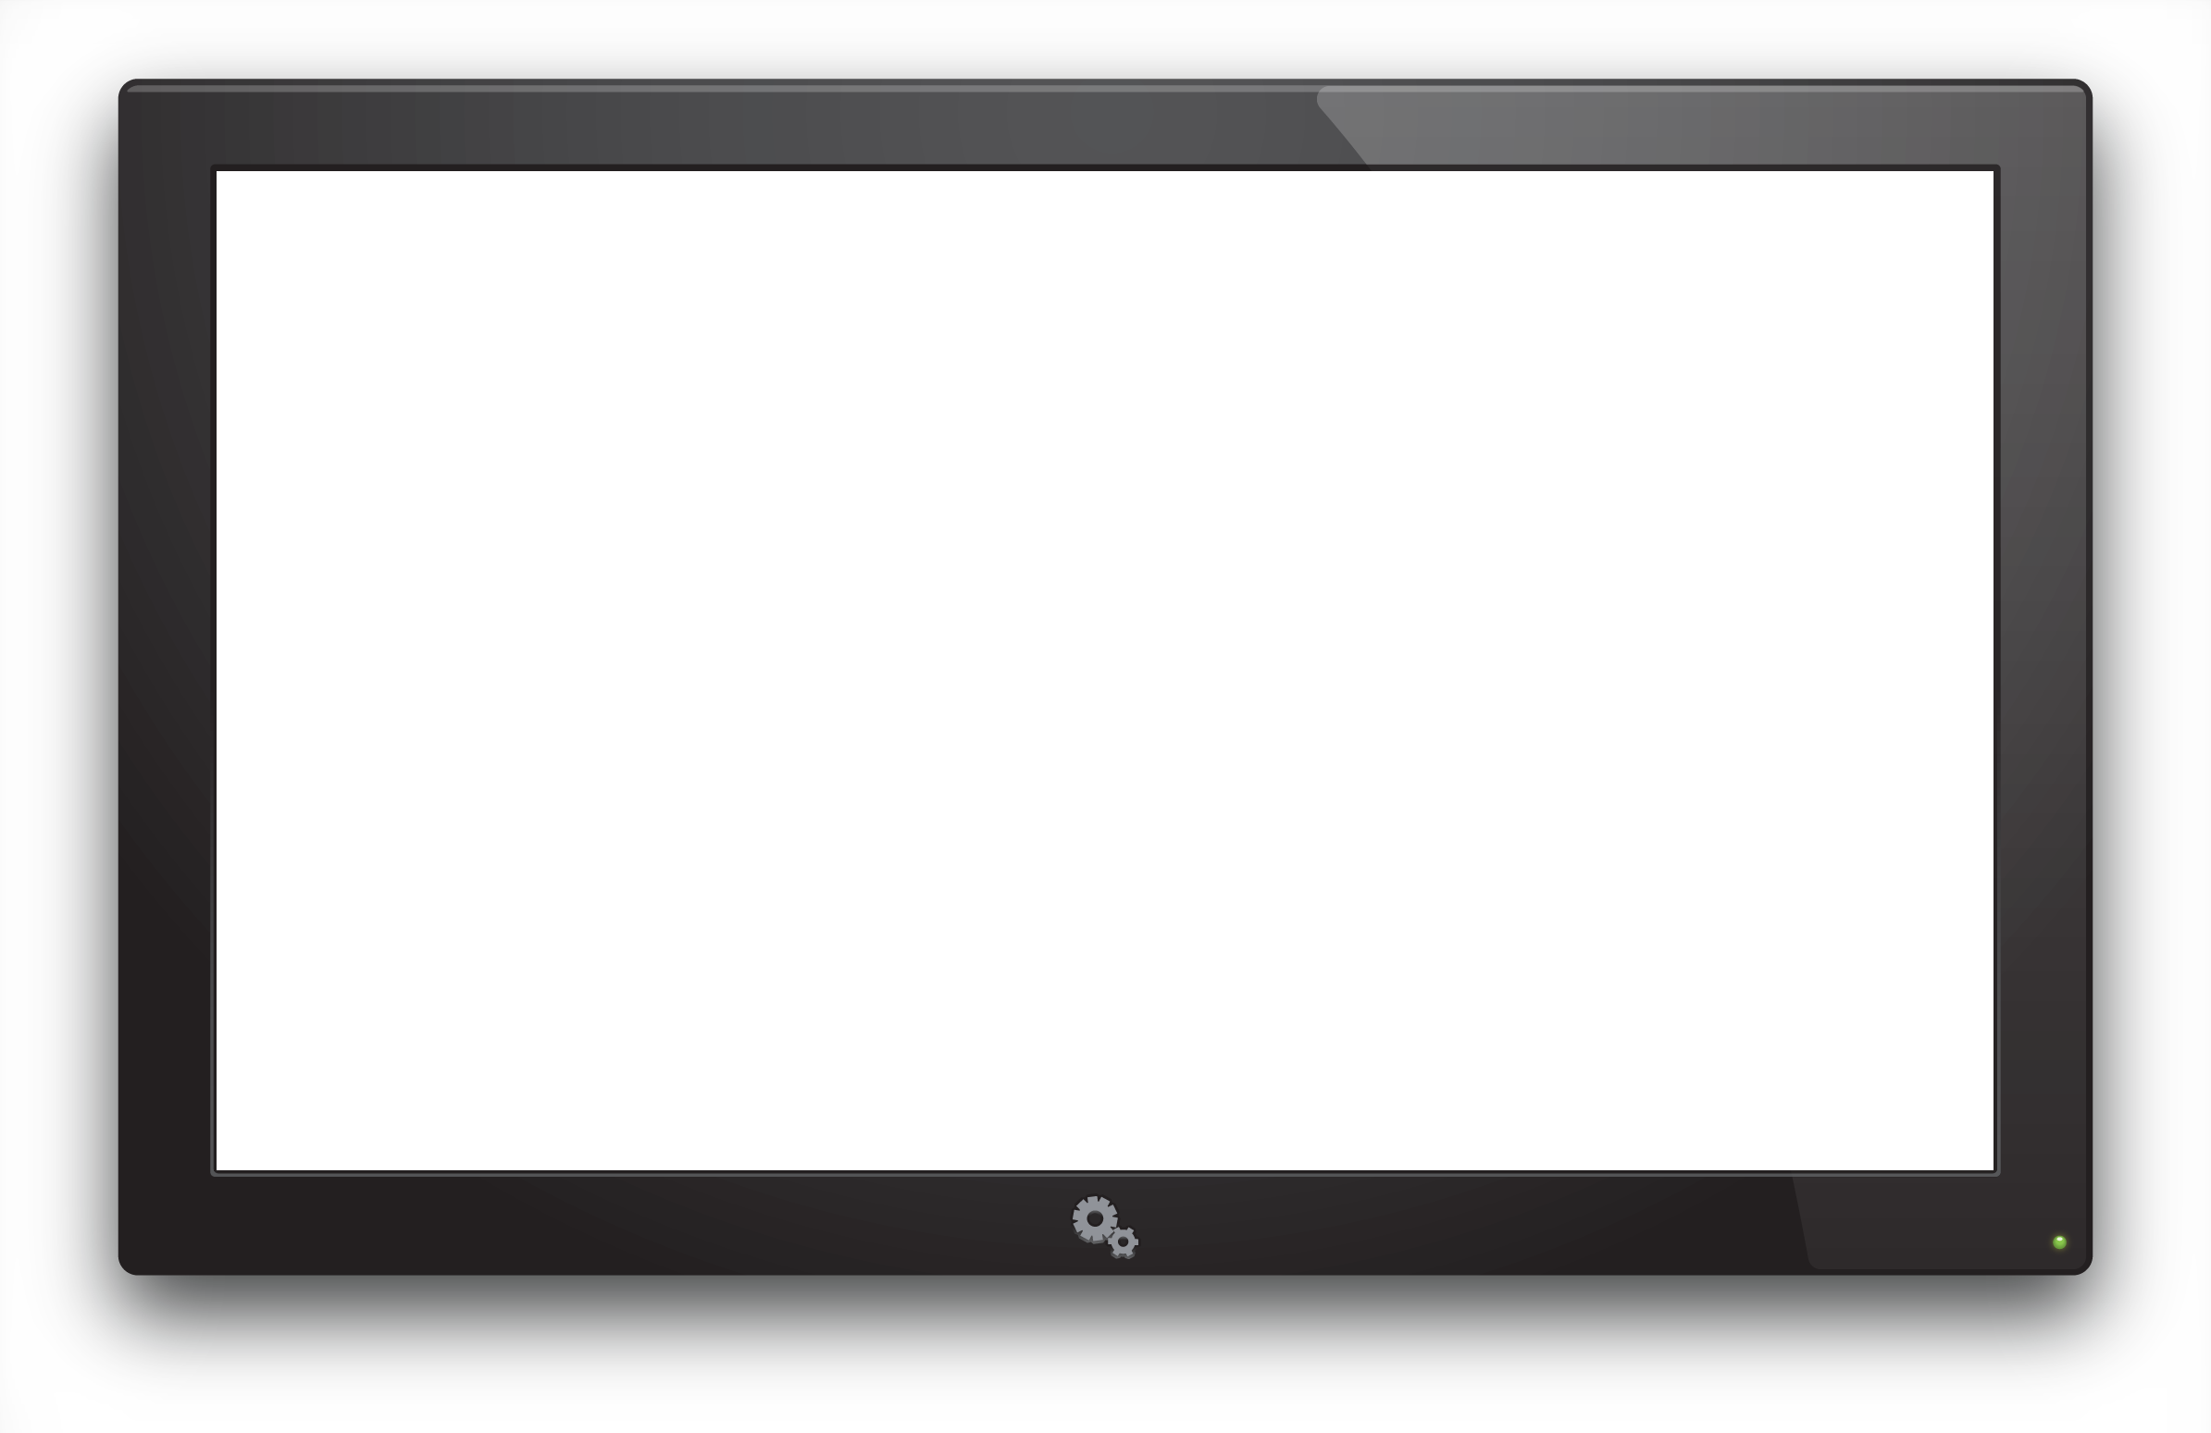
Biomechanics
XXVI International Conference on Sports rehabilitation and Traumatology
Notes:
Walking dynamic changes in base support. If we want to improve reactive response ability while our client is walking or running then we have to work using unexpected perturbation during the function. AS Woeking with standing does not nexessary result in improvement while walking.

Slide 12
Optimization of Neuromuscular system
Cutaneous
Receptors
Alpha Motor
Neuron
CNS
Articular
Receptors
Extrafusal
Fibers
Muscle
Receptors
Intrafusal
Fibers
Gamma Motor
Neuron
XXVI International Conference on Sports rehabilitation and Traumatology
Notes:
Treatment methodolgy to allow optimization. For maximum muscle performance e.g. agility, strength we need to optimize intrafusal muscle fibre tightness. Sports car 0-60 So we challenge the intraqfusal fibers through reactive response training in order to achieve optimal muscle activation.

Slide 13
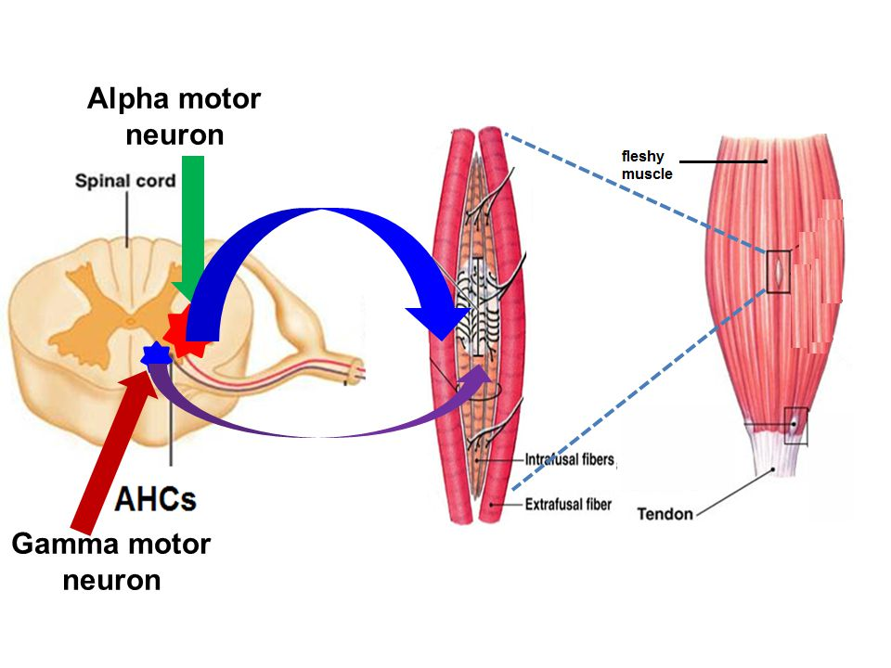
Alpha and Gamma Motor neuron
XXVI International Conference on Sports rehabilitation and Traumatology
Notes:
Objective work on muscle contraction. Spindles made up of. Intrafusal responsible for tightness. And extrafusal muscle contaraction activation. Known that Reactive works more efficiently at level of intrafusal. Tighteness = efficiency

Slide 14
Mechanoreceptors
Type | Threshold | Adaptation | Action
I | Low | Slow | Beginning of movement
II | Low | Rapidly | Beginning of movement
III | High | Slow | Extremes of movement
IV | High | Pain receptors | Extremes of movement
Classification of articular mechanoreceptors abridged (Wyke 1972)
Notes:
Reactive response training we are working on limits of speed and ROM in a safe environment. Increasing the afferent signal and working on type I ii and 111. Mushroom control ROM and speed controlled Work Ankle sprain. Increas efficiency of Type I an type II and type III and avoid injury and pain. Mushroom small rom and slow mostly type 1 and 11. Avoid adaptation.
Rapidly adapting rapidly change responsive no same signal reactive response change signal.

Slide 15
Neuromuscular activation
NMES
Muscle stretch
Reactive response
Proactive response
XXVI International Conference on Sports rehabilitation and Traumatology
Notes:
Different degrees of CNS involvement CNS involvement: Types NMES very little: 2. Reflex for diagnosis. Subcortical levels of CNS e.g. Mostly Basal ganglia and cerebellum. Proactive cortical levels. Each task need both some tasks more dominant than others. Traditional mostly on proactive. We are introducing combination and empahasising reactive.

Slide 16
Balance strategies
EQUILIBRIUM ZONE
“FALL” ZONE
Postural Responses
Step Strategy
Hip Strategy
Ankle Strategy
Perturbation Magnitude
Cordo & Nashner, 1982
XXVI International Conference on Sports rehabilitation and Traumatology
Notes:
Mushroom.

Slide 17
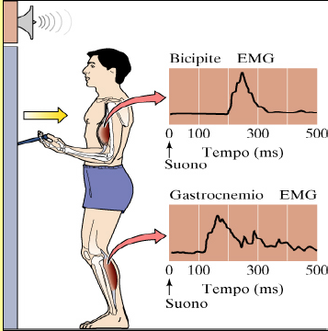
Anticipatory Postural Adjustments
Cordo & Nashner, 1982
Notes:
17
Spatial temporal synergy of proactive is different from reactive.

Slide 18
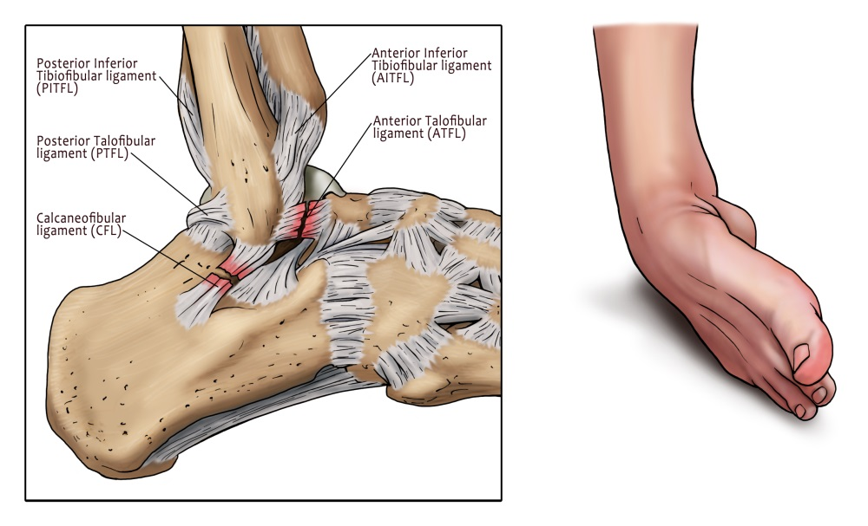
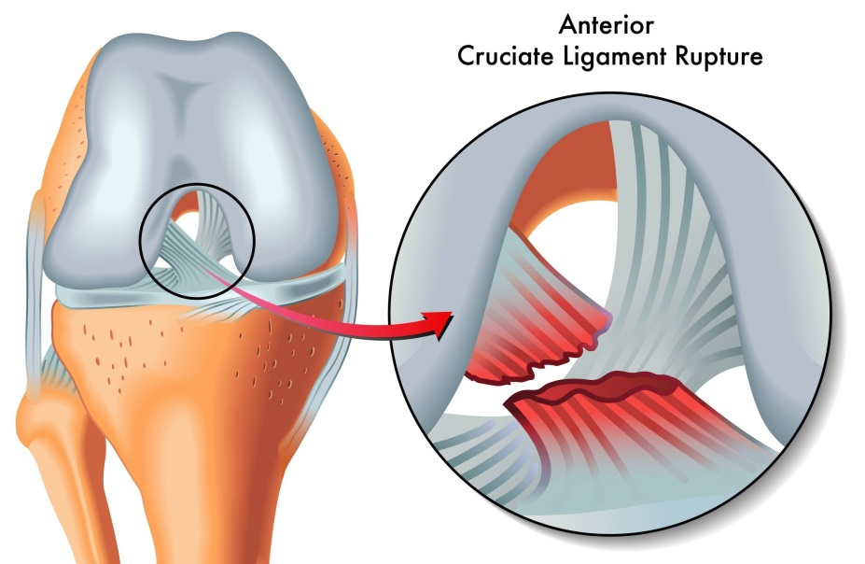
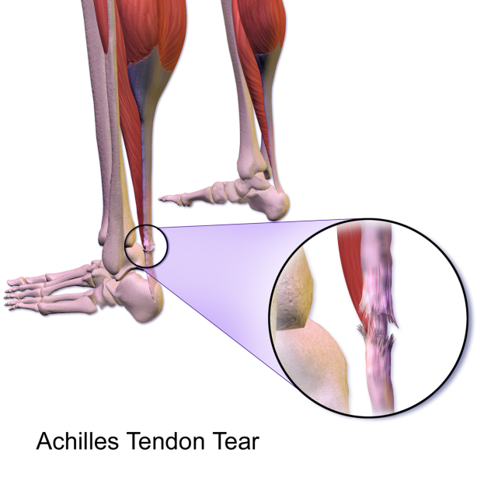
Orthopedic injuries

Slide 19
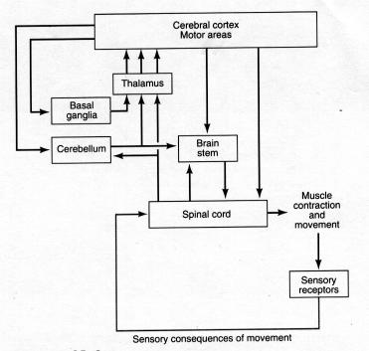
Postural control response
Spinal cord- reflex response
30-70 ms
Brain stem- automatic response
70-120 ms
Cerebral cortex- voluntary response
220-280 ms
Robert T, Neuroscience 2008
Notes:
Primary motor cortex- to encode the relevant muscle, the force and direction of the movement.
Premotor area- to organize and preparing of motor commands
Supplemental motor area- to programing complex sequences of movement that involve group of muscles.
Matthews GG. Brain motor mechanisms. 1997

Slide 20
Proprioception
Proprioceptive information plays an integral role in feedforward control.
Bard C, 1995
proprioceptive input is the most quickest and most accurate compared to other inputs such as visual input.
Ghez C. 1991
Ligament- muscle reflex are essential to joint protection due to providing of fast reaction and adequate response magnitude.
Barrack RL, 1994
XXVI International Conference on Sports rehabilitation and Traumatology

Slide 21
Rehabilitation stages
Healing
ROM & Strength
Plyometric
Agility & Balance
Return to play
Skills & Confidence
XXVI International Conference on Sports rehabilitation and Traumatology
Notes:
Plyometric are exercises in which muscles exert maximum force in short intervals of time, with the goal of increasing power (speed-strength). This training focuses on learning to move from a muscle extension to a contraction in a rapid or "explosive" manner

Slide 22
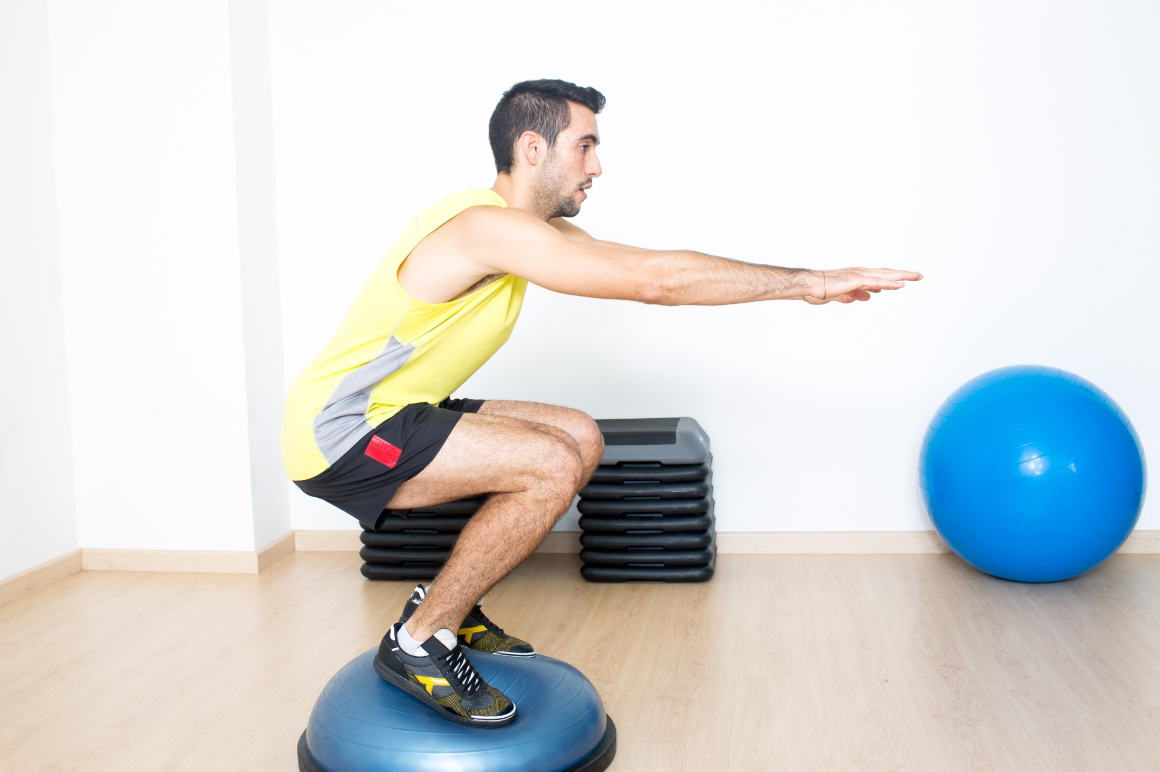
Is this optimal proprioceptive training?
Notes:
No:
1.. Explain why this is proactive. Instructions and only move according to ability so within limits.
2. Tilt Centre of mass and not shifting. In every day function COM is shifting.
3. Only standing and not walking.
Ankle sprain:

Slide 23
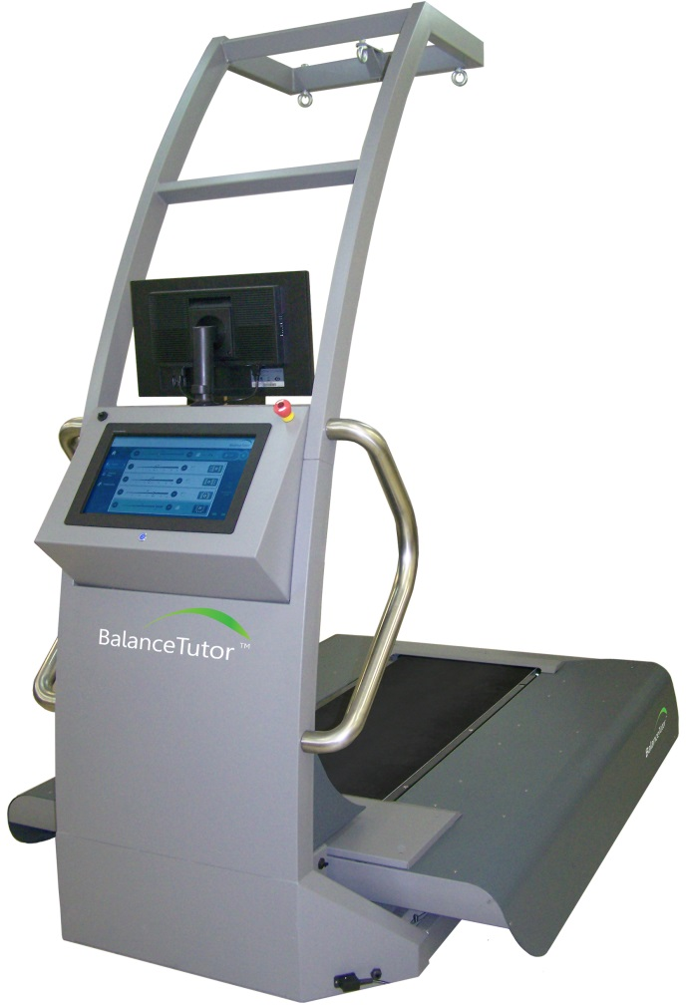
BalanceTutor
XXVI International Conference on Sports rehabilitation and Traumatology
Notes:
The BalanceTutor by MediTouch is an Unexpected Perturbation Treadmill. This innovative system for postural control and balance training consists of a moving force plate platform. The platform moves in the medial/ lateral and forward/ backward plains to simulate a slip and a trip in both the standing and walking phase. A series of professional controlled expected and unexpected perturbations at different speed and acceleration provided by the system, improves patient’s balance and postural control ability in standing, walking and running.

Slide 24
BalanceTutor system
XXVI International Conference on Sports rehabilitation and Traumatology

Slide 25
BalanceTutor system
XXVI International Conference on Sports rehabilitation and Traumatology
Notes:
Return to play

Slide 26
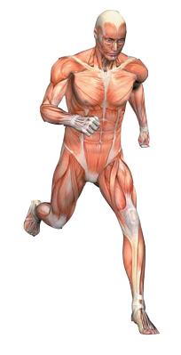
Sensory- motor Rehabilitation
Neuromuscular coordination
Neuromuscular integration
Proprioceptive restoration
XXVI International Conference on Sports rehabilitation and Traumatology
Notes:
Pro restoration: early stage of amplitude target ligaments. Isolated repetitions of controlled movements. Increase amplitude target all muscle groups in knee. And coordination increasing spatial temporal coordination response e.g perturbation during walking. Involve more muscle activation

Slide 27
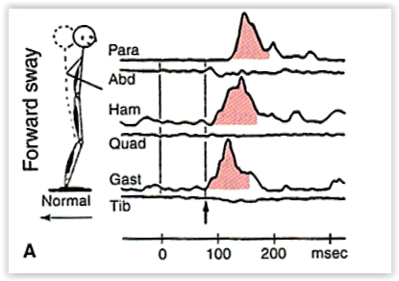
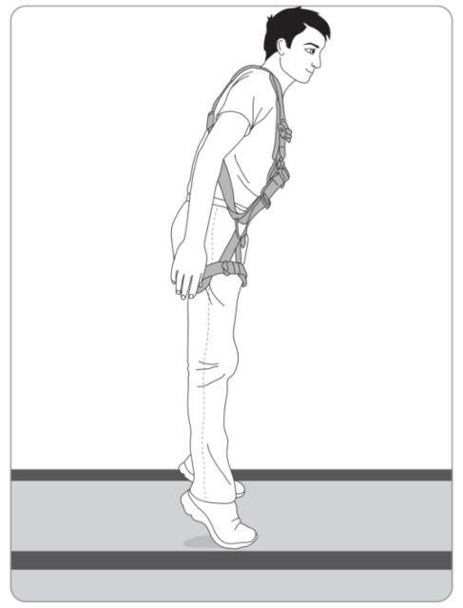
Rehabilitation Target
Ankle flexion
Strategy: Ankle strategy
Perturbation direction: Anterior to posterior
Perturbation level: Low intensity
Perturbation effect: Distal to proximal muscles activation
Clinical application: Plyometric ankle flexors activation
Horak & Nashner, 1986

Slide 28
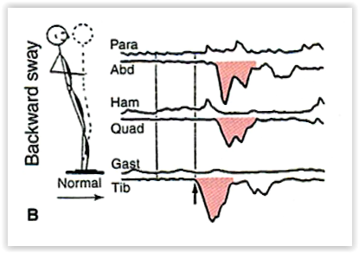
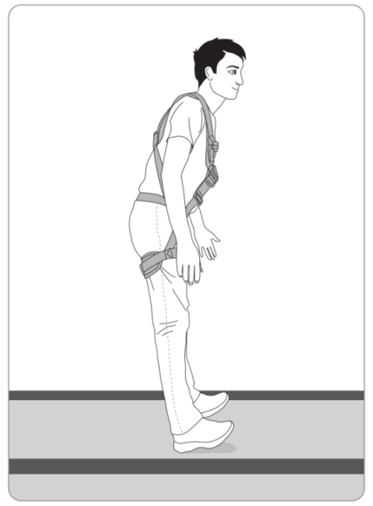
Rehabilitation Target
Ankle extension
Strategy: Ankle strategy
Perturbation direction: Posterior to anterior
Perturbation level: Low intensity
Perturbation effect: Distal to proximal muscles activation
Clinical application: Plyometric ankle extensors activation
Horak & Nashner, 1986

Slide 29
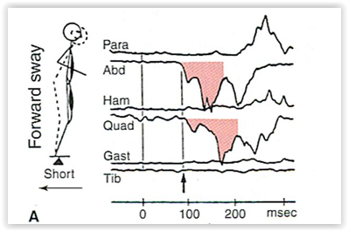
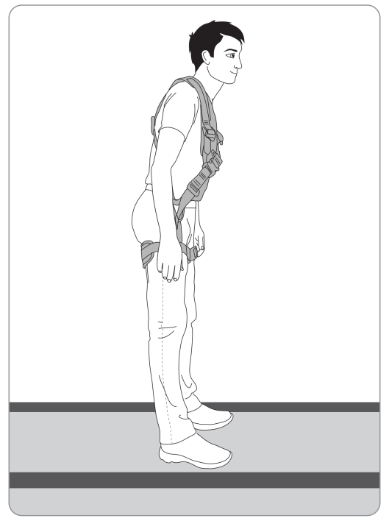
Rehabilitation Target
Hip flexion
Strategy: Hip strategy
Perturbation direction: Anterior to posterior
Perturbation level: Medium intensity
Perturbation effect: proximal to distal muscles activation
Clinical application: Plyometric abdominal activation
Horak & Nashner, 1986

Slide 30
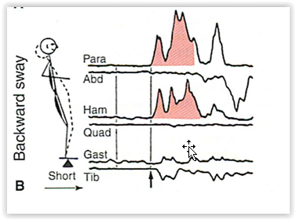
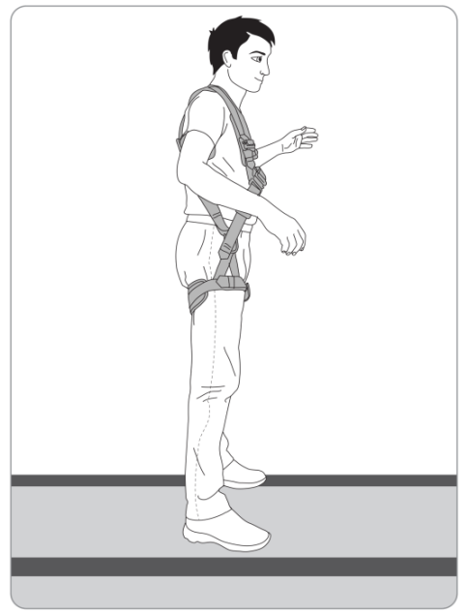
Rehabilitation Target
Hip extension
Strategy: Hip strategy
Perturbation direction: posterior to anterior
Perturbation level: Medium intensity
Perturbation effect: Proximal to distal muscles activation
Clinical application: Plyometric back muscle activation
Horak & Nashner, 1986

Slide 31
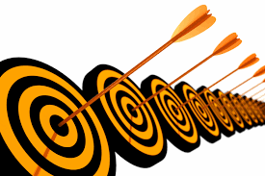
Indications
XXVI International Conference on Sports rehabilitation and Traumatology

Slide 32
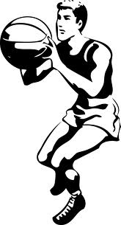
Musculoskeletal rehabilitation
Muscle / tendon strain
Post sport injury rehabilitation
Athletes training
Muscle weakness
Ligament strain
XXVI International Conference on Sports rehabilitation and Traumatology

Slide 33
Unique features
Proprioceptive rehabilitation
Automatic response assessment
Customized training
Post injury rehabilitation
Recurrent injury prevention
Objective reports & documentation
XXVI International Conference on Sports rehabilitation and Traumatology

Slide 34
Wide range of abilities
XXVI International Conference on Sports rehabilitation and Traumatology

Slide 35
meditouch.co.il

